Slide 1
USER
GUIDE

Slide 2
TABLE OF CONTENTS
CREATING A PLAYBOOK
SHARING A PLAYBOOK
VIEWING A PLAYBOOK
CHANGING A PLAYBOOK
IN-APP DIRECT MESSAGING
USER ACCOUNTS
IN-APP HELP
DESIGNING A PLAYBOOK
Parallel is a procedure management system that gives enterprises control of their procedures to maximize outcomes.
This document details Parallel’s capabilities & functionality.

Slide 3
PARALLEL WORKSPACES
YOUR NEW PLAYBOOK
1
YOUR TEAM’S NEW PLAYBOOK
2
CREATING MORE PLAYBOOKS
3
CREATING A PLAYBOOK
A Parallel Playbook is a private website where your team can share & view procedures as well as communicate.

Slide 4
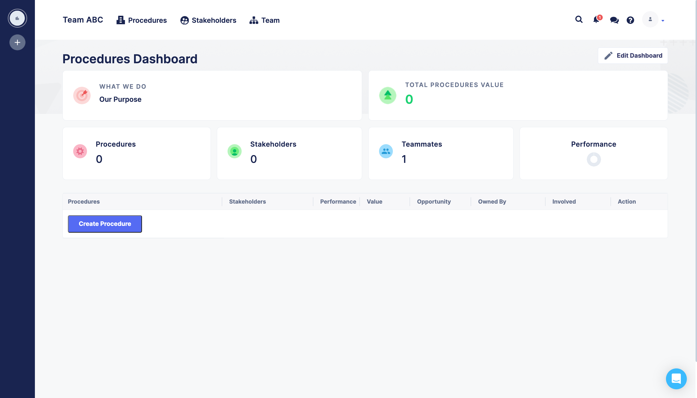
YOUR NEW PLAYBOOK
1
Contains:
ZERO PROCEDURES
ZERO STAKEHOLDERS
1 TEAM MEMBER
NEW PLAYBOOK

Slide 5
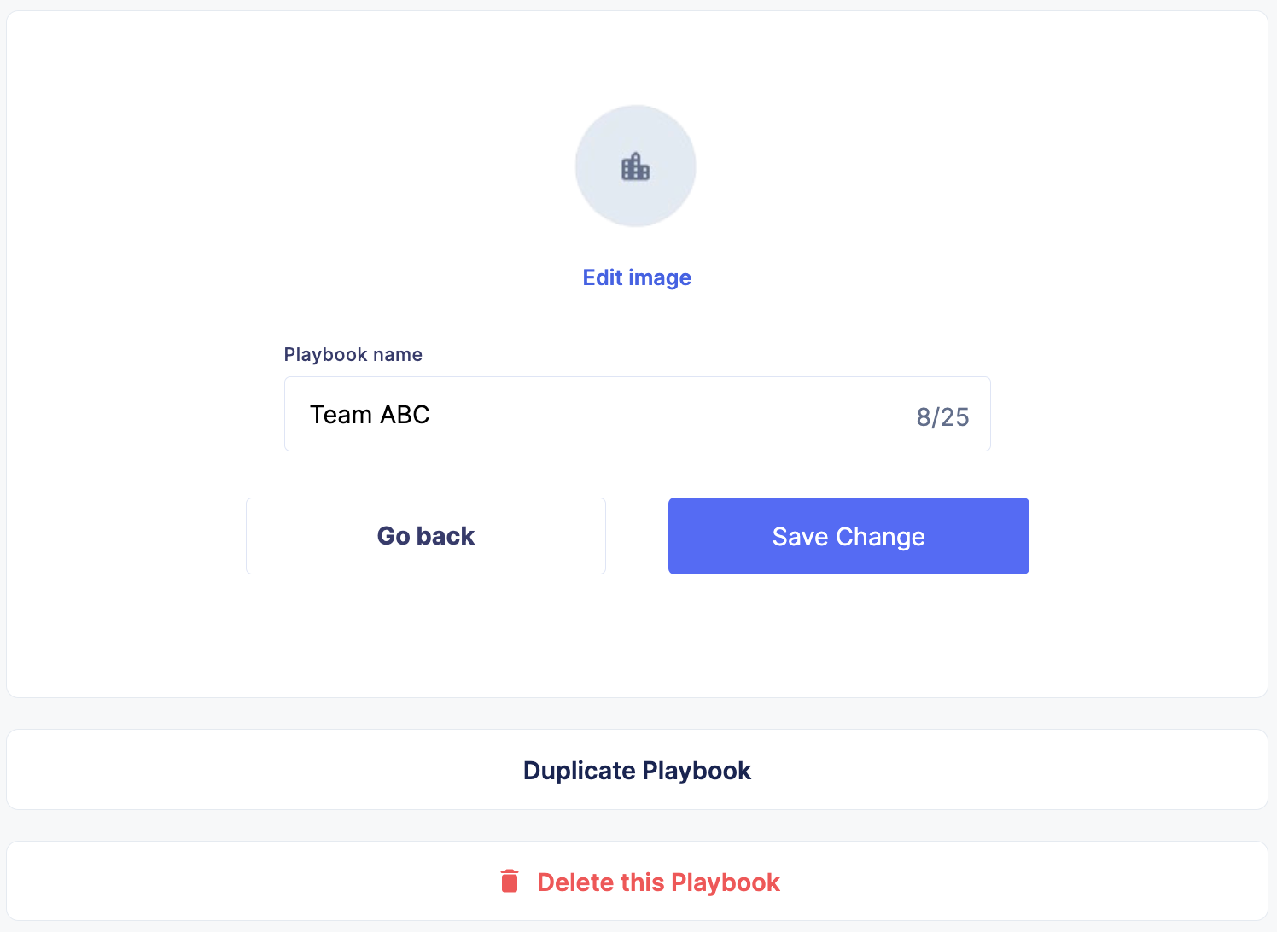
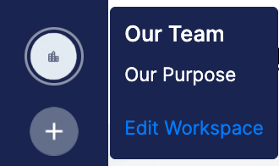
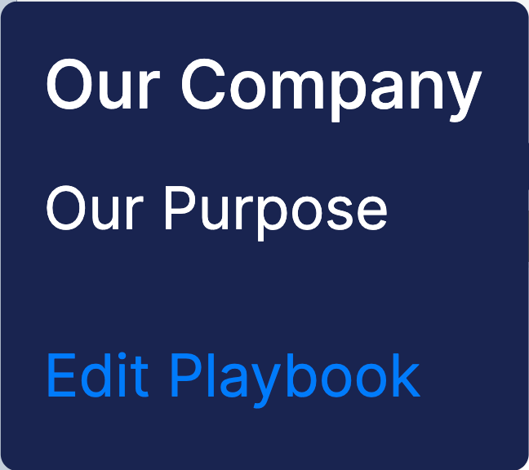
YOUR TEAM’S NEW PLAYBOOK
2
The dark blue bar on the left is your playbook manager.
Rolling over the top circle reveals your playbook’s name & purpose and provides a link to add your team’s name and logo.
NEW PLAYBOOK

Slide 6
CREATING MORE PLAYBOOKS
3
Clicking the circle with the + creates new playbooks.
NEW PLAYBOOK

Slide 7
PARALLEL WORKSPACES
ADDING PROCEDURE SUB-GOALS
2
CREATING PROCEDURES
1
ADDING STAKEHOLDER INFORMATION
4
ADDING SUB-GOAL INFORMATION
3
DESIGNING A PLAYBOOK
Parallel helps leaders share procedures, edit procedures & communicate change in a single motion.

Slide 8
CREATING PROCEDURES
1
On the Procedures Dashboard, users can create a procedure and have the option to catalog the procedure by:
THE STAKEHOLDER BEING SERVED
CURRENT PERFORMANCE
MONETARY VALUE
OPPORTUNITY
TEAM/INDIVIDUAL OWNER
WHO ELSE IS INVOLVED

Slide 9
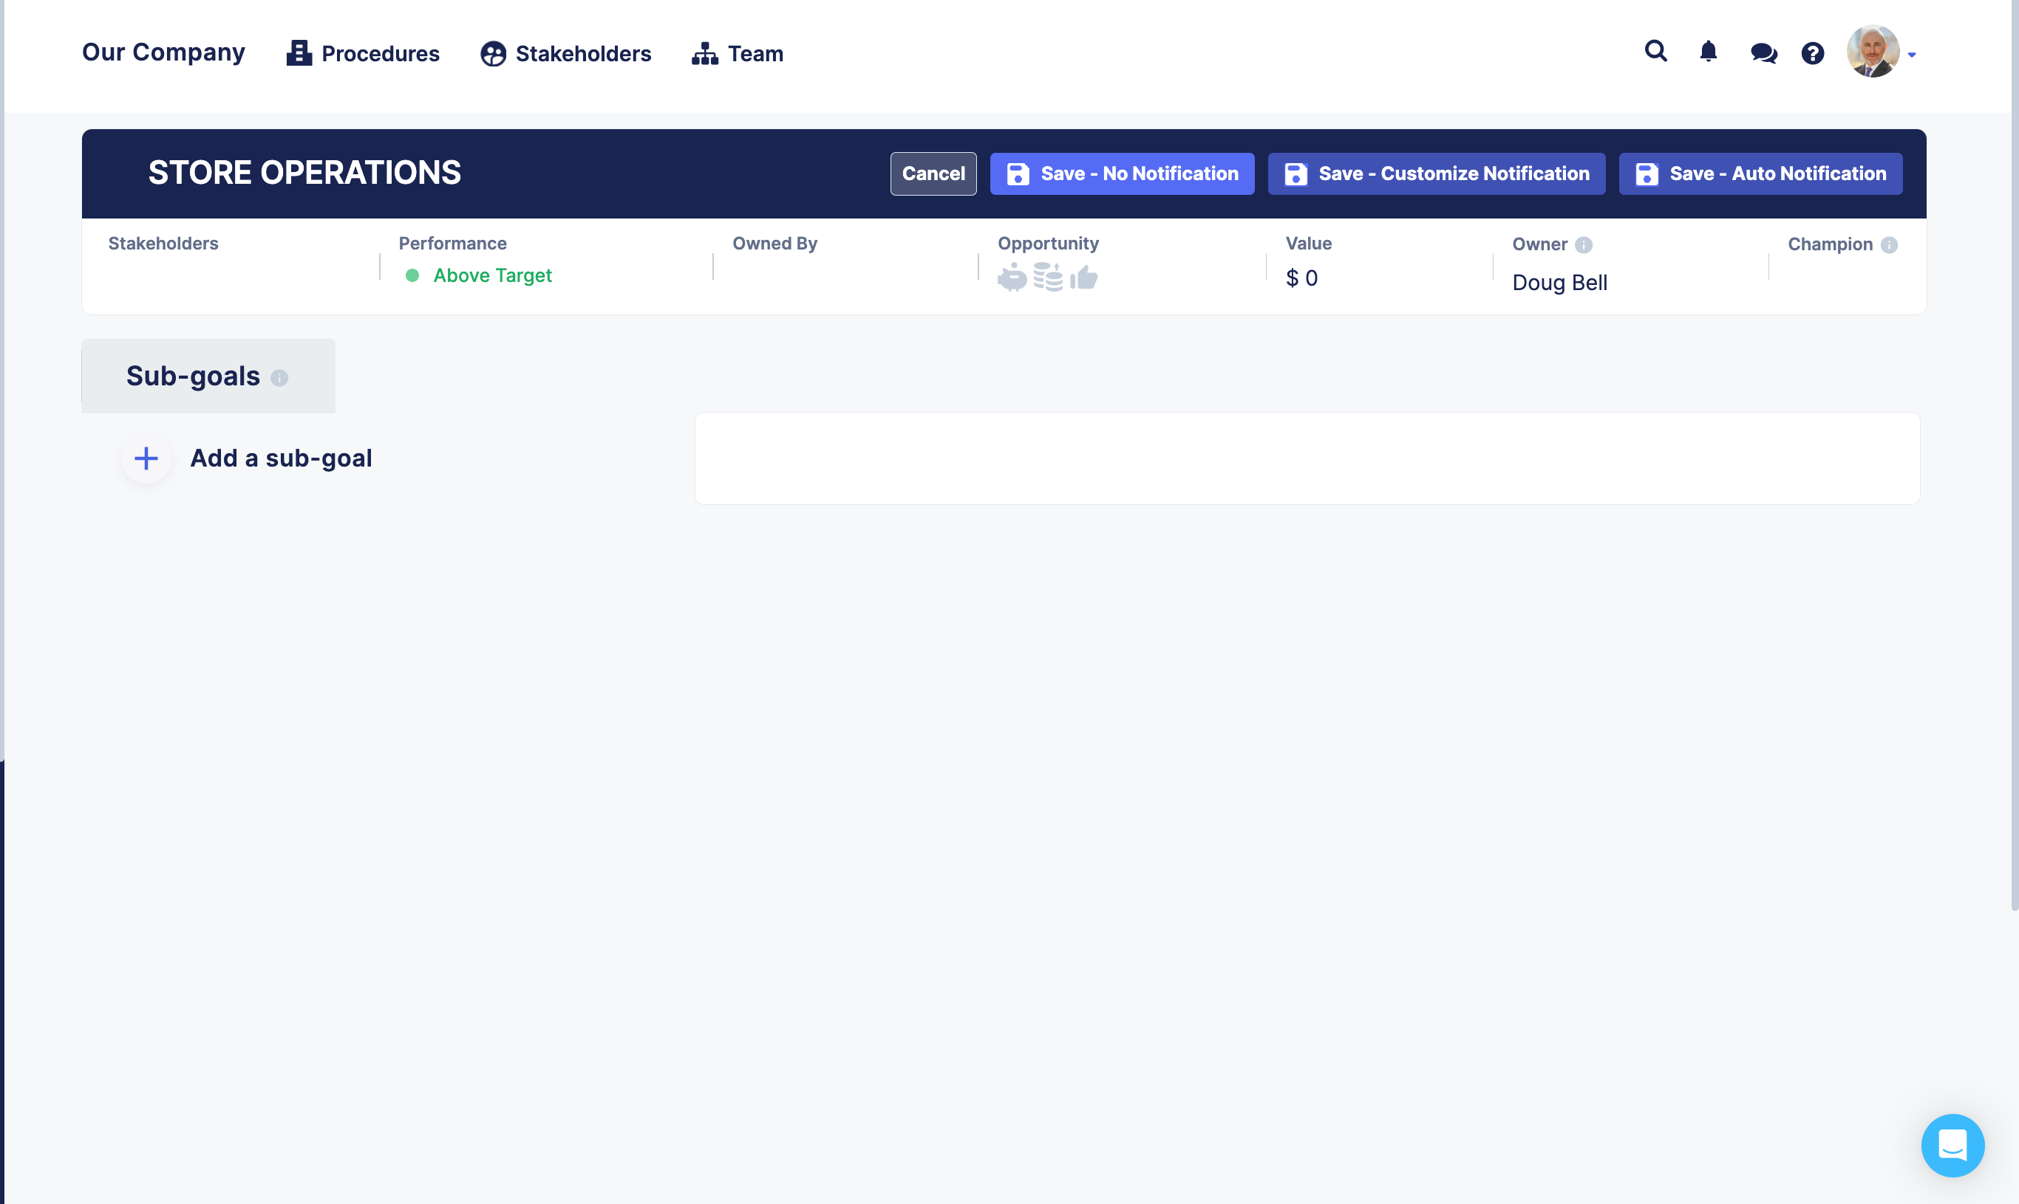
ADDING PROCEDURE SUB-GOALS
2
On a Procedure’s page, users can add procedure sub-goals that would need to be achieved for overall procedure success:
BY CLICKING Add a sub-goal
THE ‘STORE OPERATIONS’ PROCEDURE

Slide 10
ADDING SUB-GOAL INFORMATION
3
After adding a sub-goal, users have the option to add sub-goal information:
SUB-GOAL TEAM OWNER
SUB-GOAL STATUS
SUB-GOAL OWNER
SUB-GOAL TEXT
SUB-GOAL RESOURCES (FILES & LINKS)
SUB-GOAL MOMENTS OF TRUTH
EDITING SUB-GOAL INFORMATION

Slide 11
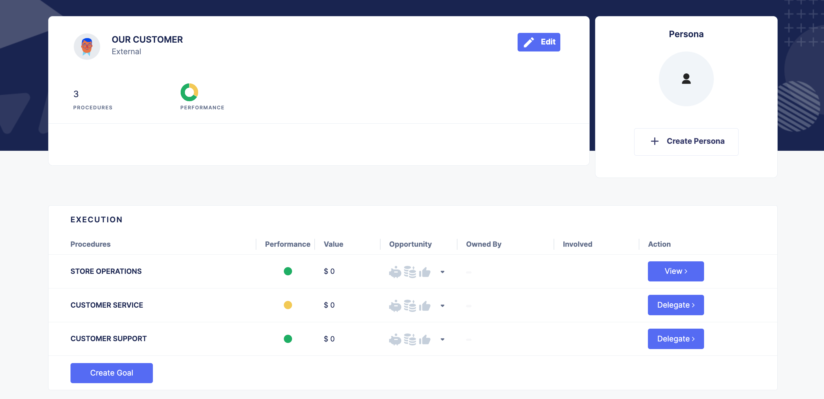
ADDING STAKEHOLDER INFORMATION
4
On a Stakeholder Page, users have the option to share information about the stakeholder:
STAKEHOLDER STRATEGY
BY CLICKING Edit
A STAKEHOLDER PERSONA
BY CLICKING Create Persona
A STAKEHOLDER PAGE

Slide 12
PARALLEL WORKSPACES
GRANTING PERMISSIONS
2
INVITING YOUR TEAM
1
ASSIGNING ROLES
3
SHARING A PLAYBOOK
By inviting your team into your playbook, you can always keep everyone in-sync.

Slide 13
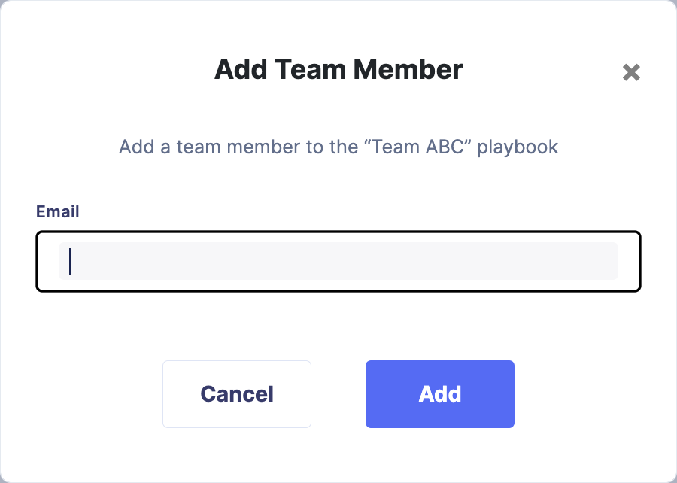
INVITING YOUR TEAM
1
Clicking on Team opens the Team page where new members can be added by:
CLICKING ON THE Add Member icon.
TYPING an email address.
CLICKING the Add button.
Michael Mathews
mmathews@acme.com
NEW PLAYBOOK

Slide 14
GRANTING PERMISSIONS
2
On the Team page, the following playbook permissions can be granted:
ADMIN
HAS FULL PLAYBOOK CONTROL. THEY CAN EDIT EVERYTHING, ADD/REMOVE USERS, AND MANAGE USER PERMISSIONS & ROLES.
BILLING
HAS FULL ACCESS TO BILLING. THEY CAN ADD AND UPDATE PAYMENT & SUBSCRIPTION TYPES. THEY ALSO HAVE ACCESS TO VIEW INVOICES AND SEE PAYMENT HISTORY.
Michael Mathews
mmathews@acme.com
TEAM PAGE

Slide 15
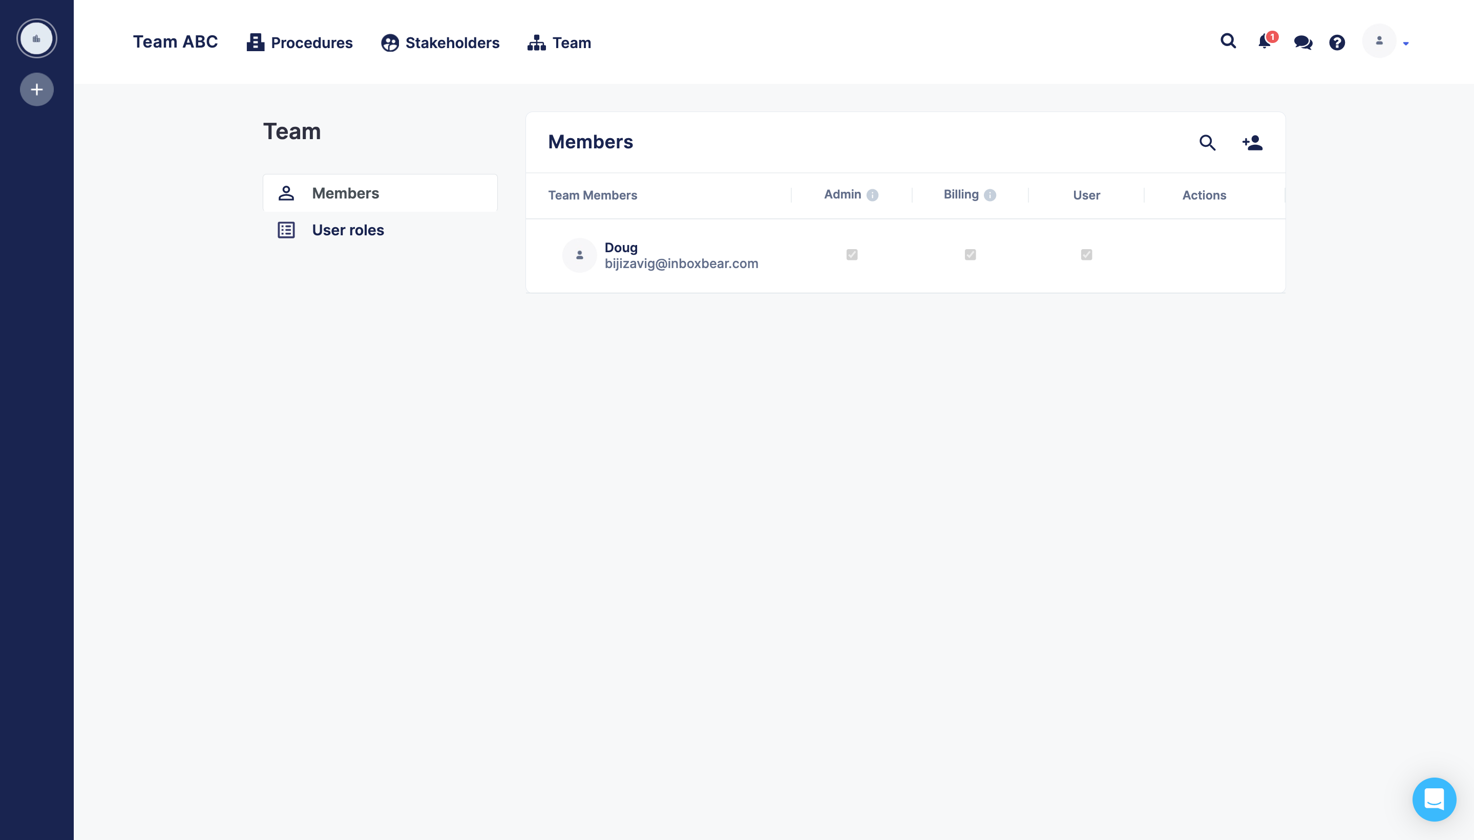
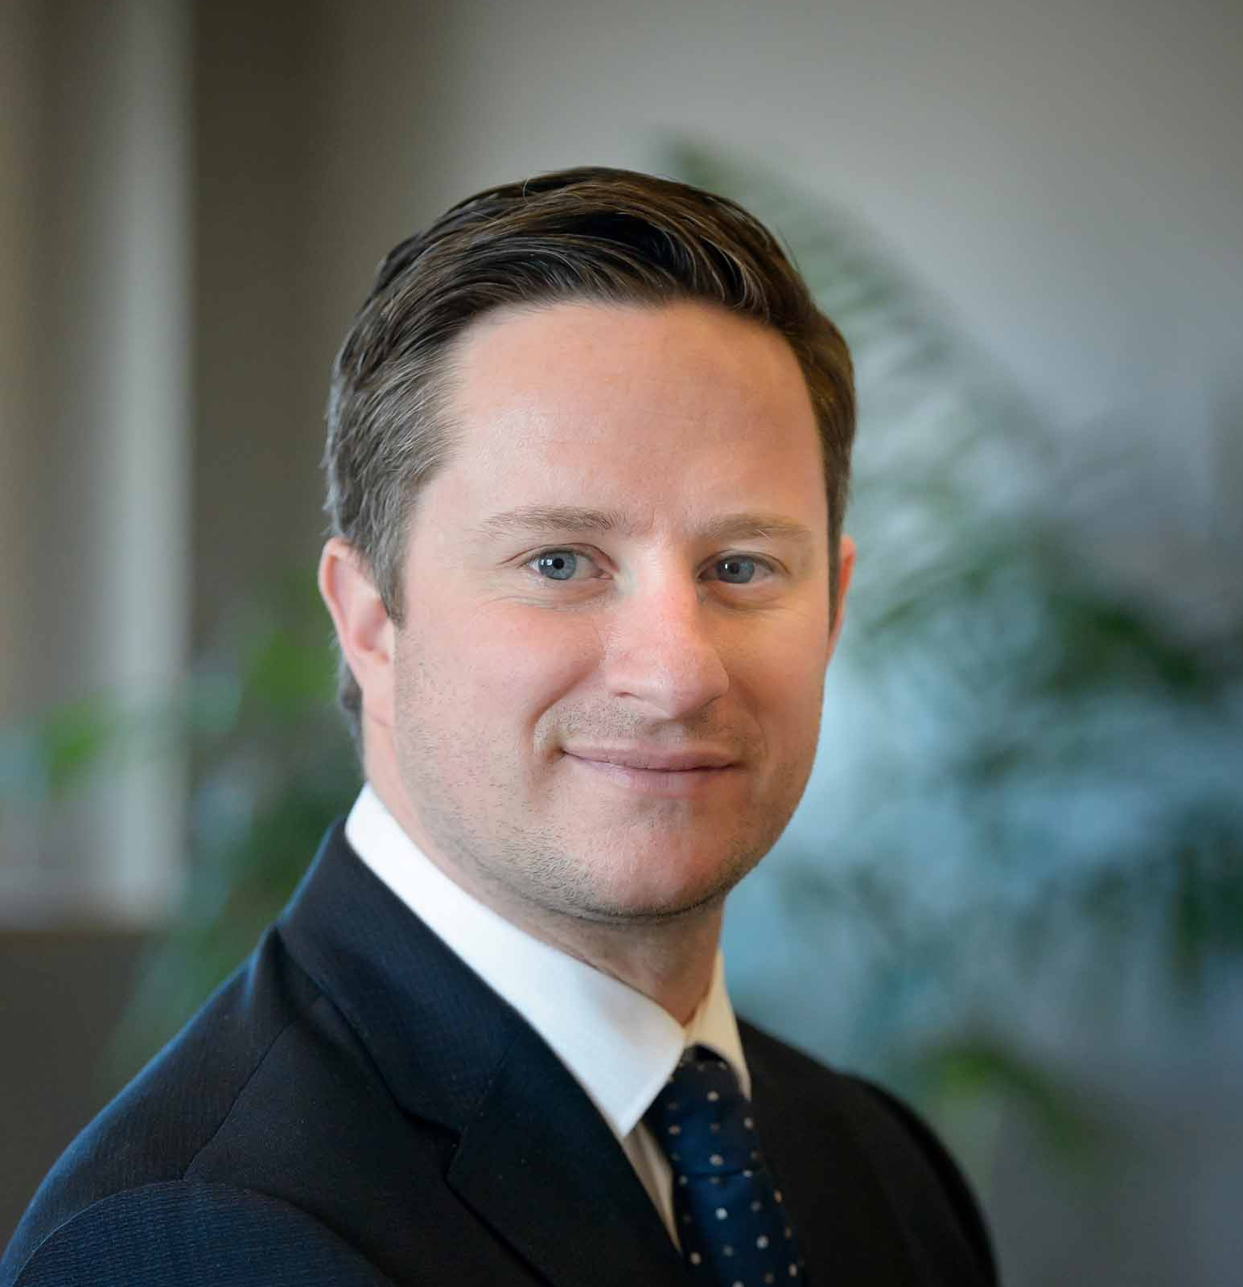
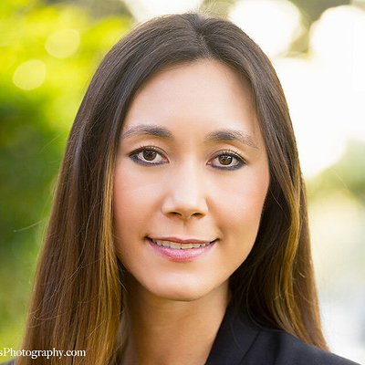
ASSIGNING ROLES
3
For each procedure, leaders can be assigned roles:
OWNERS & CHAMPIONS
WHO ARE RESPONSIBLE FOR THE SUCCESS OF THE PROCEDURE
AND
EDITORS
WHO CAN EDIT THE PROCEDURE
Maxwell Morton
Gwen Garrett
Mason Woods
Erika Morgan
USER ROLES FOR THE ‘STORE OPERATIONS’ PROCEDURE

Slide 16
YOUR PROCEDURES DASHBOARD
1
YOUR STAKEHOLDERS DASHBOARD
2
SEARCH
3
VIEWING A PLAYBOOK
Team Members can view their team’s procedures by name, stakeholder, or search making them easy to find when they are needed.

Slide 17
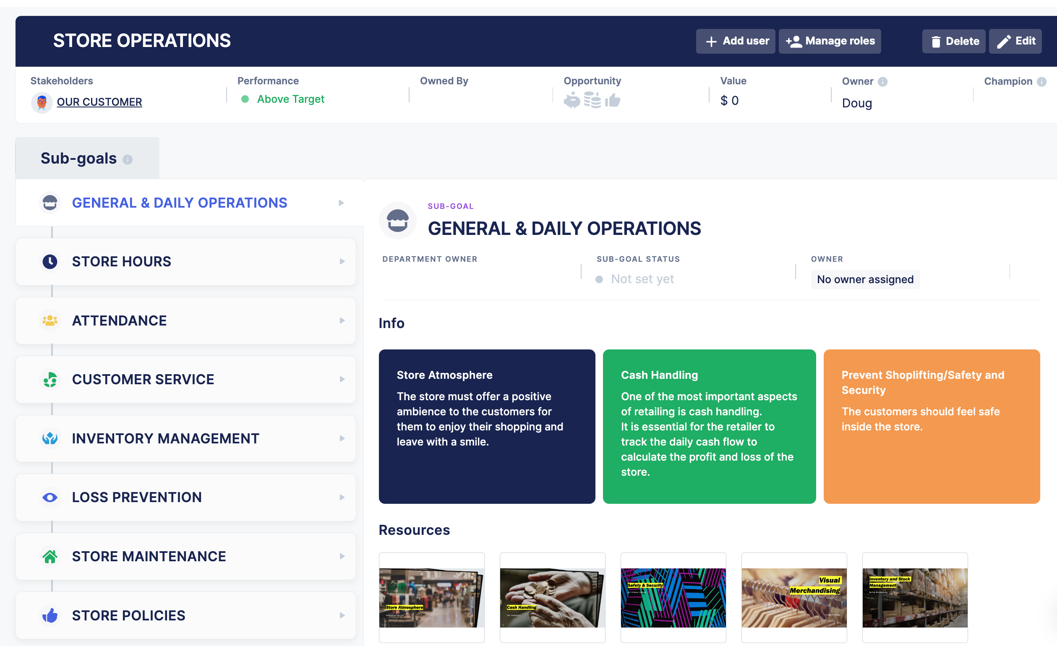
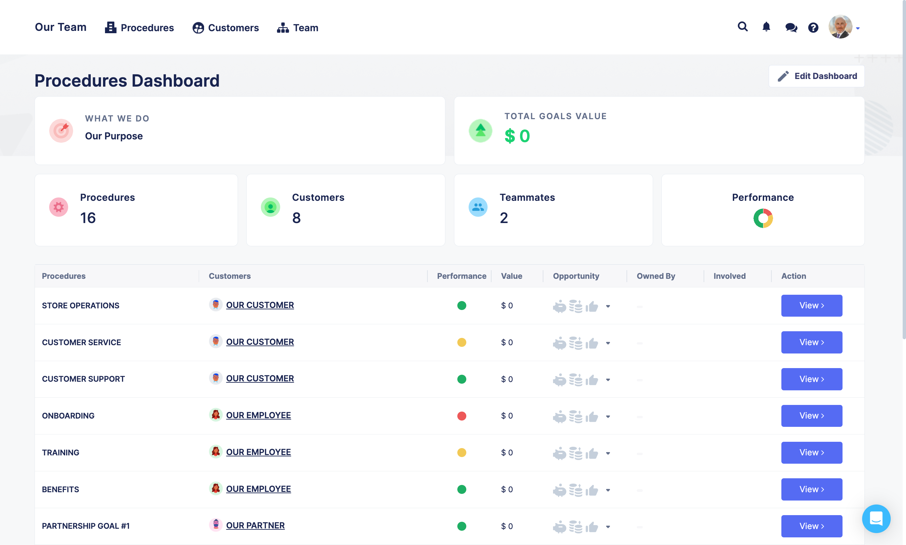
YOUR PROCEDURES DASHBOARD
1
Your Procedures Dashboard is your landing page when logging into Parallel.
Clicking on any procedure on your Procedures Dashboard takes you to that procedure’s page.

Slide 18
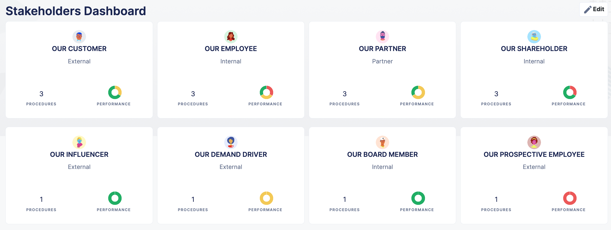
YOUR STAKEHOLDERS DASHBOARD
2
Clicking on Stakeholders opens your Stakeholders Dashboard where you can find & view the procedures you need by stakeholder.

Slide 19
SEARCH
3
Team members can search by procedure name or procedure sub-goal to find & view the information they need.

Slide 20
CHANGING A PLAYBOOK
Each user receives notifications of the procedure changes that are important & relevant to them in their roles making it incredibly easy to stay in-sync.
IN-APP NOTIFICATIONS
2
DAILY ‘CHANGE NEWS’
3
CREATING NOTIFICATIONS OF CHANGES
1

Slide 21
CREATING NOTIFICATIONS OF CHANGES
1
As they save changes to procedures or stakeholders, users have the option of:
NO NOTIFICATION
FOR CHANGES THAT DON’T REQUIRE COMMUNICATION
A CUSTOM NOTIFICATION
TELLING THE TEAM EXACTLY WHAT THEY NEED TO KNOW AND POINTING THEM TO THE CHANGE MADE
AN AUTO NOTIFICATION
THE SYSTEM NOTIFIES THE TEAM AND POINTS THEM TO THE CHANGE MADE

Slide 22
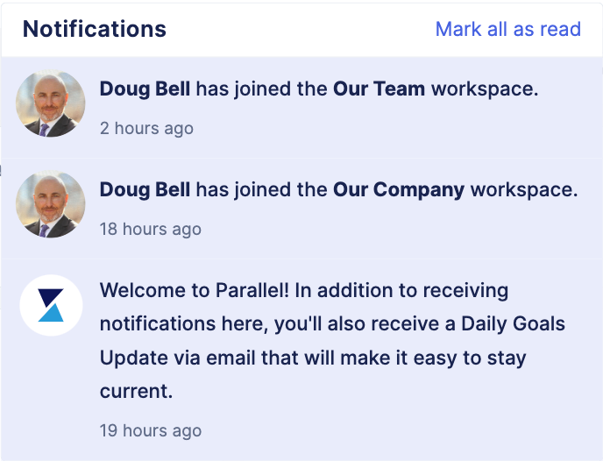
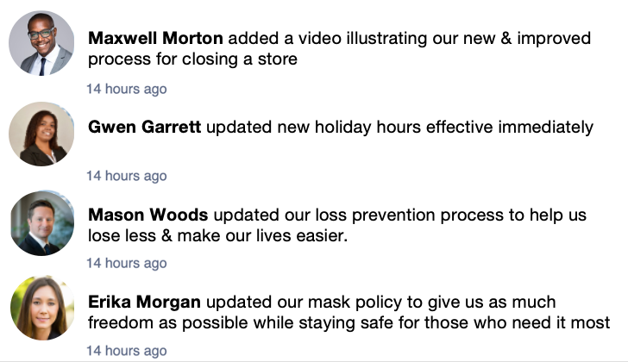
IN-APP NOTIFICATIONS
2
When in Parallel, users receive notifications of changes as they are communicated in real time.

Slide 23
DAILY ‘CHANGE NEWS’
3
Outside of Parallel. Users receive a daily CHANGE NEWS email with an aggregated list of change communications.
Each communication links to the detailed procedure change made in Parallel.

Slide 24
DIRECT MESSAGING
IN-APP DIRECT MESSAGING
Parallel users can message each other directly inside the app.

Slide 25
USER ACCOUNTS
Parallel users can manage their accounts with ease.
PROFILE & PASSWORD
1
USER SETTINGS
2

Slide 26
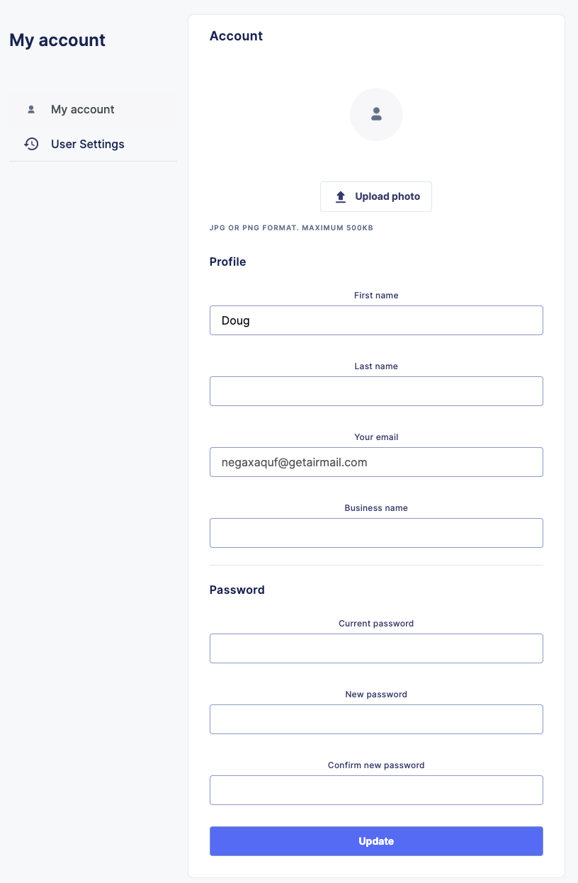
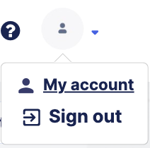
PROFILE & PASSWORD
1
Change your profile or update your password by clicking on the personal icon in the top right corner and then by clicking My account.

Slide 27
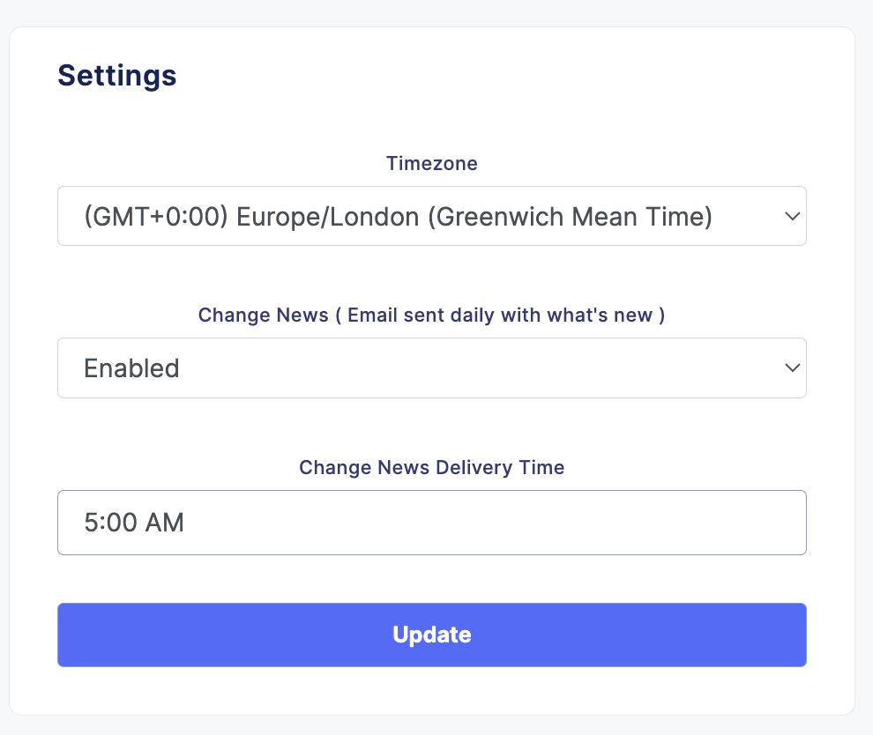
USER SETTINGS
2
Update your time zone & schedule the delivery of your daily CHANGE NEWS email by clicking on User Settings from the My account screen.

Slide 28
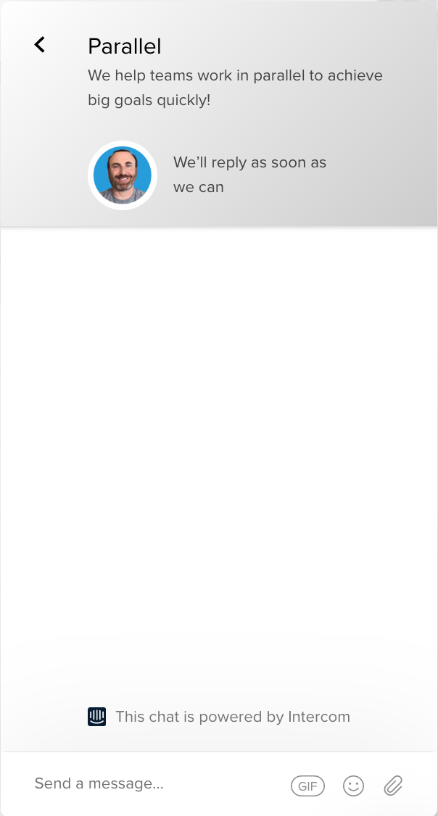
GETTING IN-APP HELP
IN-APP HELP
Users have direct access to the Parallel Team by clicking the the bright blue button that always appears in the bottom right corner of the screen.

